Slide 1
Federated Machine Learning
Evan Johnson, PhD

Slide 2
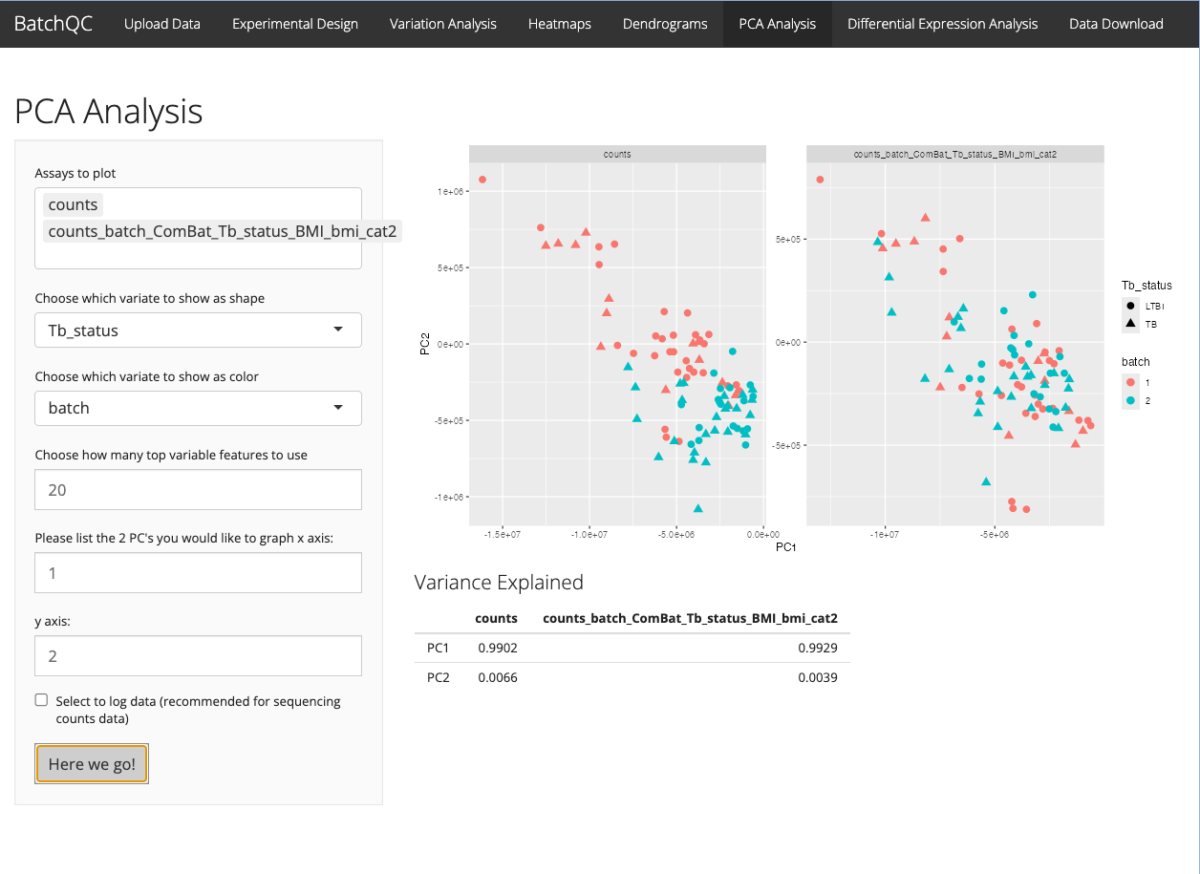

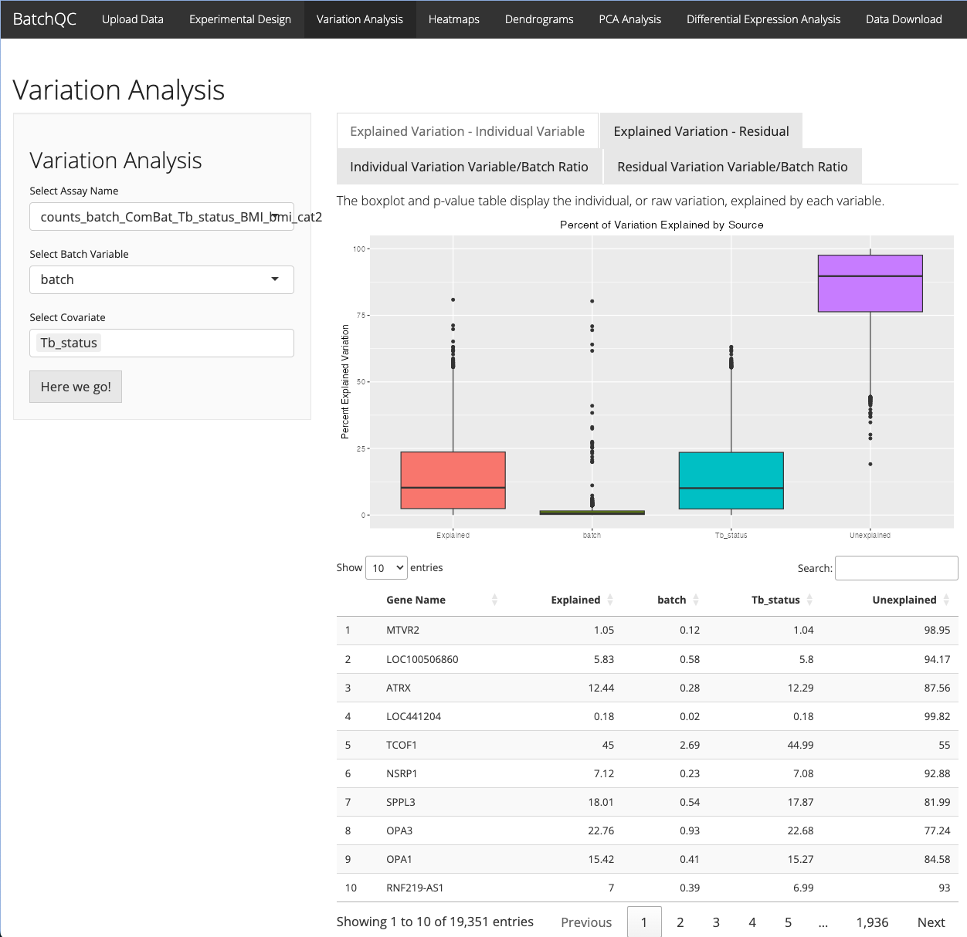
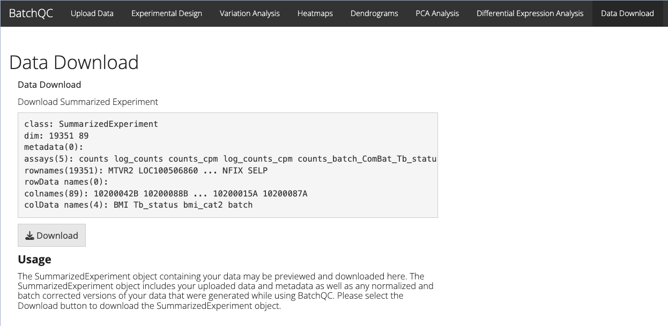
BatchQC: Evaluating Study/Batch Effects
Test for Negative Binomial Assumption
Apply multiple batch correction methods (including ComBat-Seq)
Evaluate need for batch
Interactive Visualizations
Compare original and batch corrected data side by side
Export corrected data
Shiny App or R functions
Jessica McClintock
Solaiappan Manimaran

Slide 3
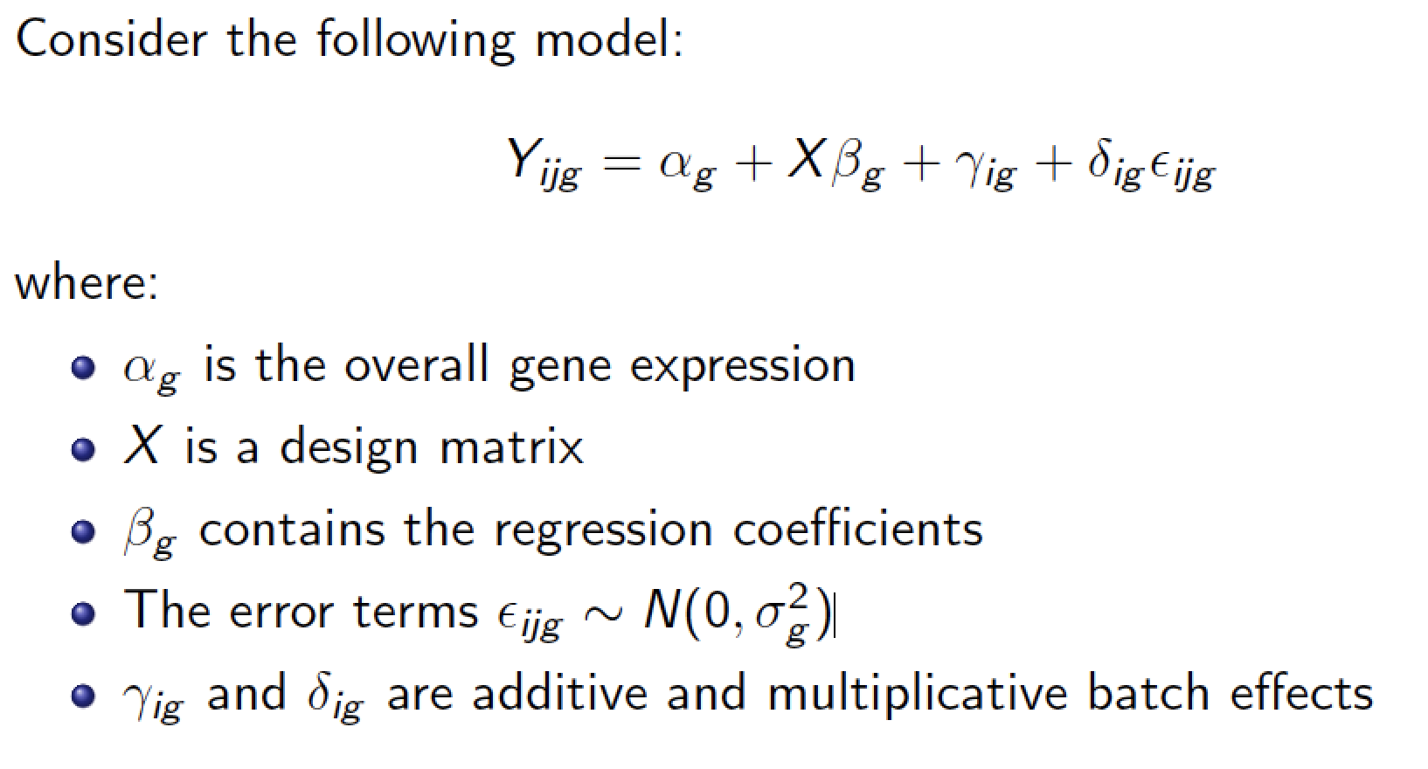
Combining Batches (ComBat) of -omics or imaging data
Johnson, et al. "Adjusting batch effects in microarray expression data using empirical Bayes methods." Biostatistics, 2007

Slide 4
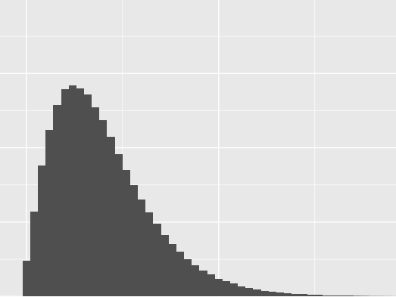
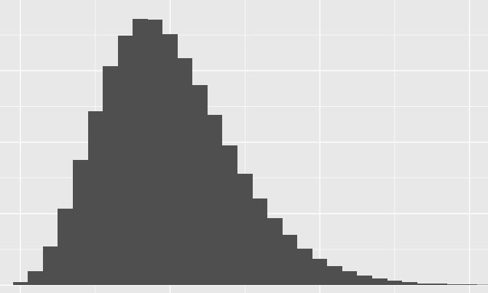
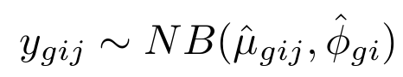
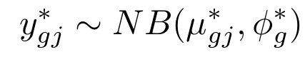
ComBat-Seq algorithm for Batch/Study Effects
Adjust the data
Original count matrix
Adjusted count matrix
 | S 1 | S 2
G 1 | 14 | 12
G 2 | 0 | 0
G 3 | 112 | 11
…
 | S 1 | S 2
G 1 | 9 | 8
G 2 | 0 | 0
G 3 | 60 | 47
…
Empirical distribution of original counts:
Batch-free distribution for adjusted counts:
Yuqing Zhang
12
8
Zhang, et al. "ComBat-seq: batch effect adjustment for RNA-seq count data." NAR Genomics Bioinformatics., 2020
Notes:
Mapping from NB to NB - still integers

Slide 5
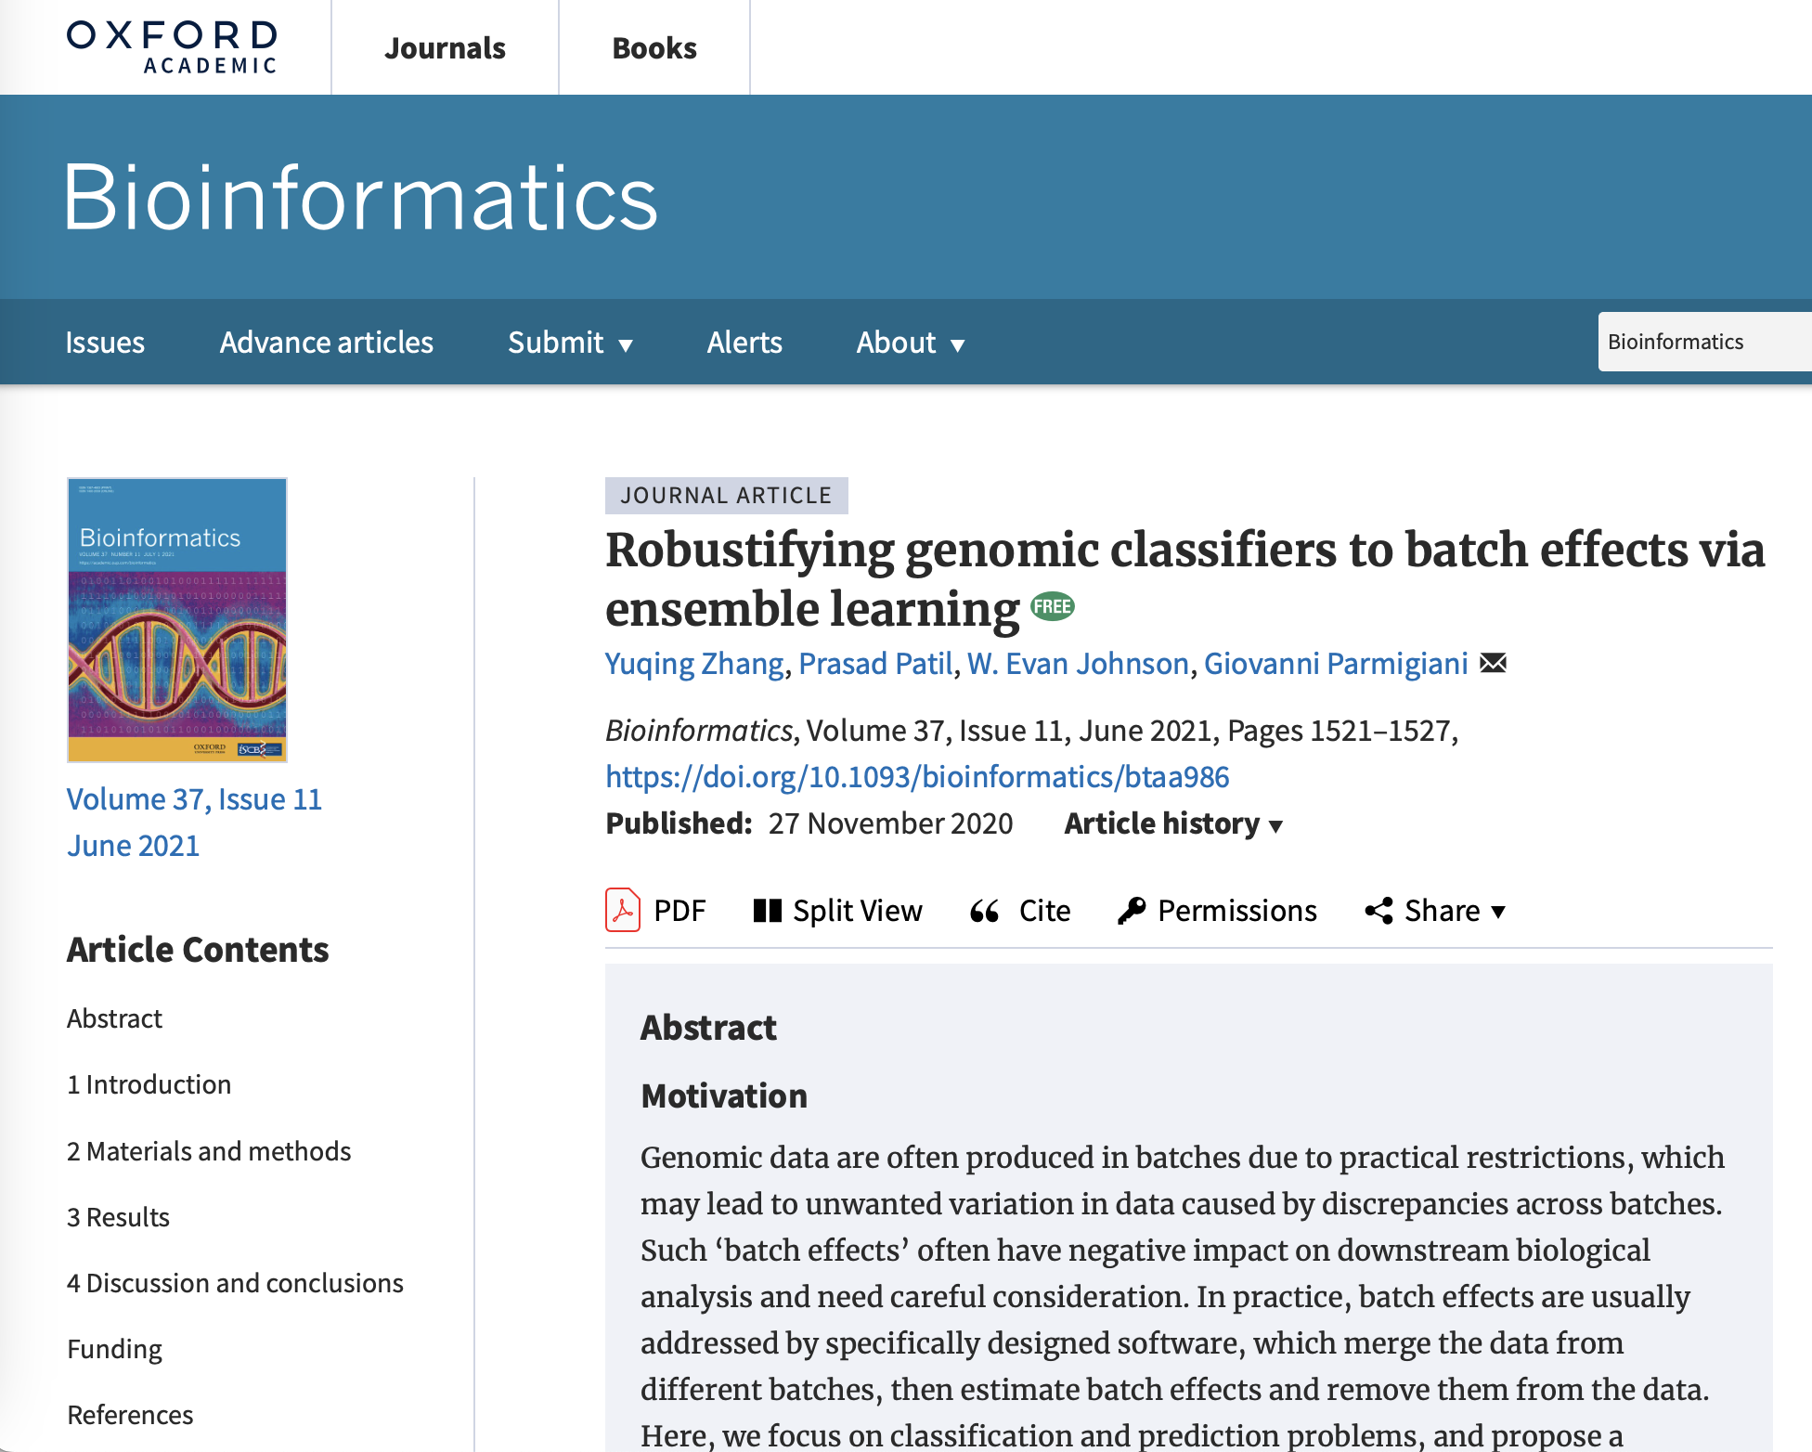

Yuqing Zhang
Prasad Patil
Giovanni Parmigiani

Slide 6

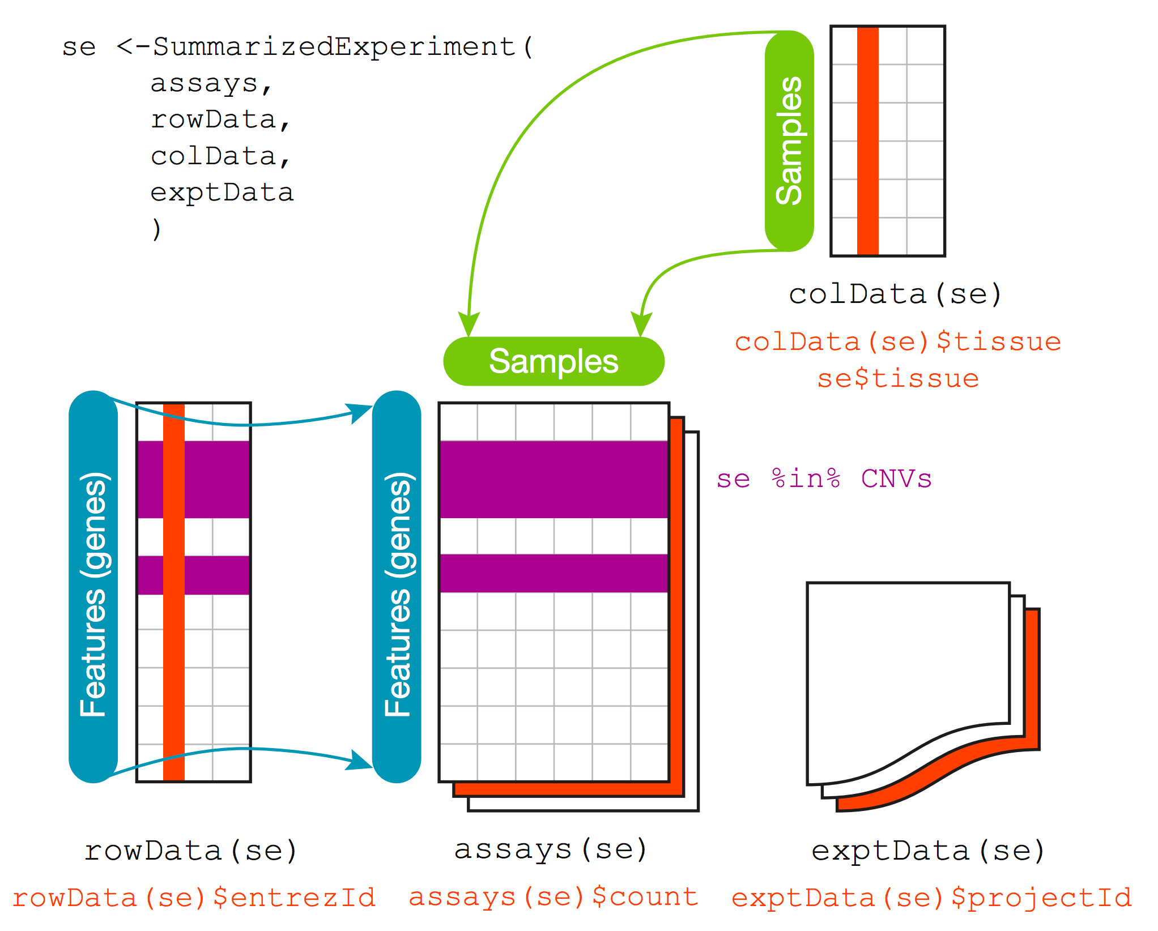
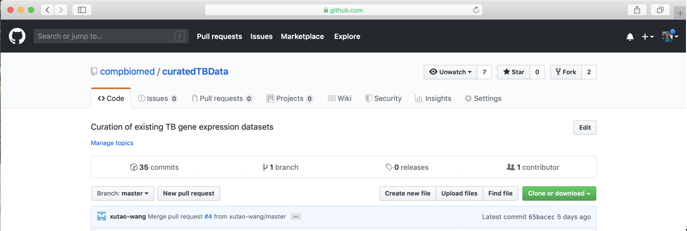
The curatedTBData Project
Curate expression data: currently 42+ TB experiments—more than 4,000 samples!
Multiple platforms (array, sequencing, etc)
Using SummarizedExperiment Objects in R
Resource for biomarker validation/development!
Dr. Prasad Patil
Xutao Wang
https://github.com/compbiomed/curatedTBData

Slide 7
Multi-Source Learning and Domain Adaptation
Traditional models:
Training and testing datasets are distributed identically. Violated by:
covariate shift
distribution gap
Multi-study learning
Common for multiple datasets with shared covariates and outcomes:
Inefficient to rely on one data source for training
Multi-source domain adaptation:
Merge all training studies
Keep each training dataset separately
Dr. Prasad Patil
Xutao Wang

Slide 8
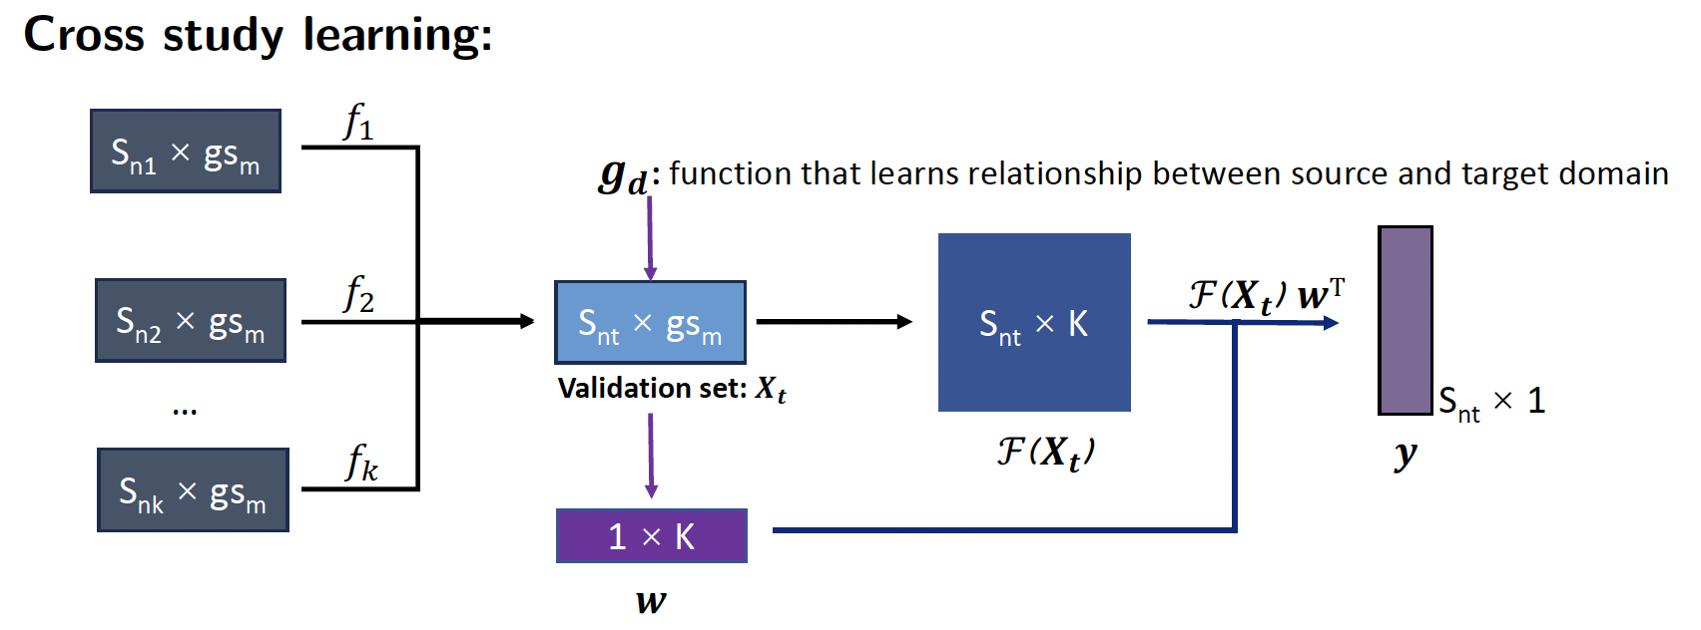
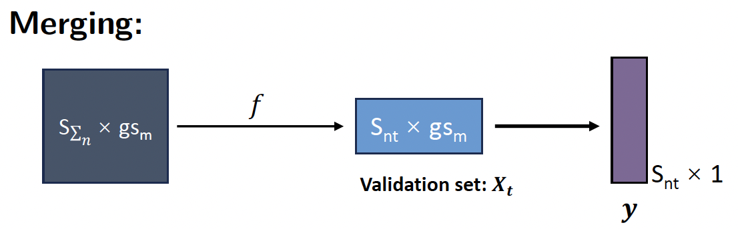
Multi-Source Learning and Domain Adaptation
Dr. Prasad Patil
Xutao Wang

Slide 9
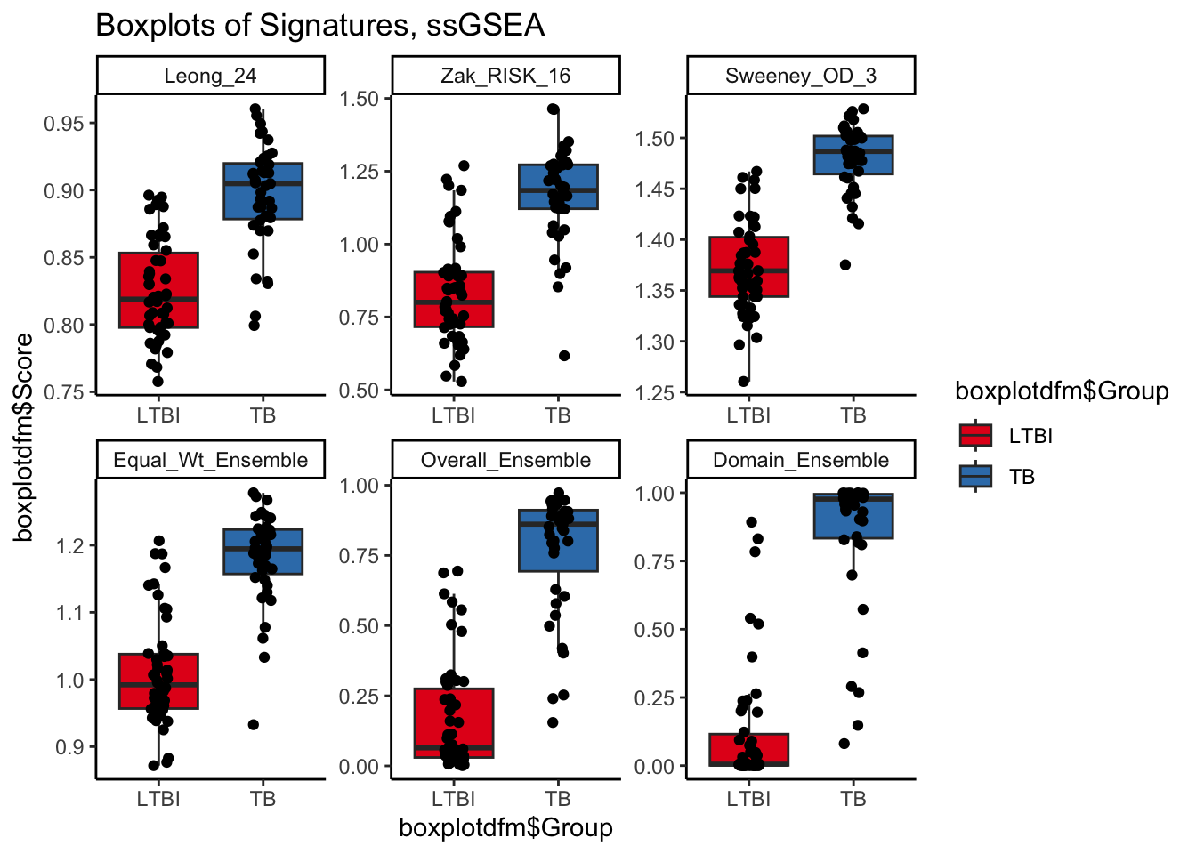
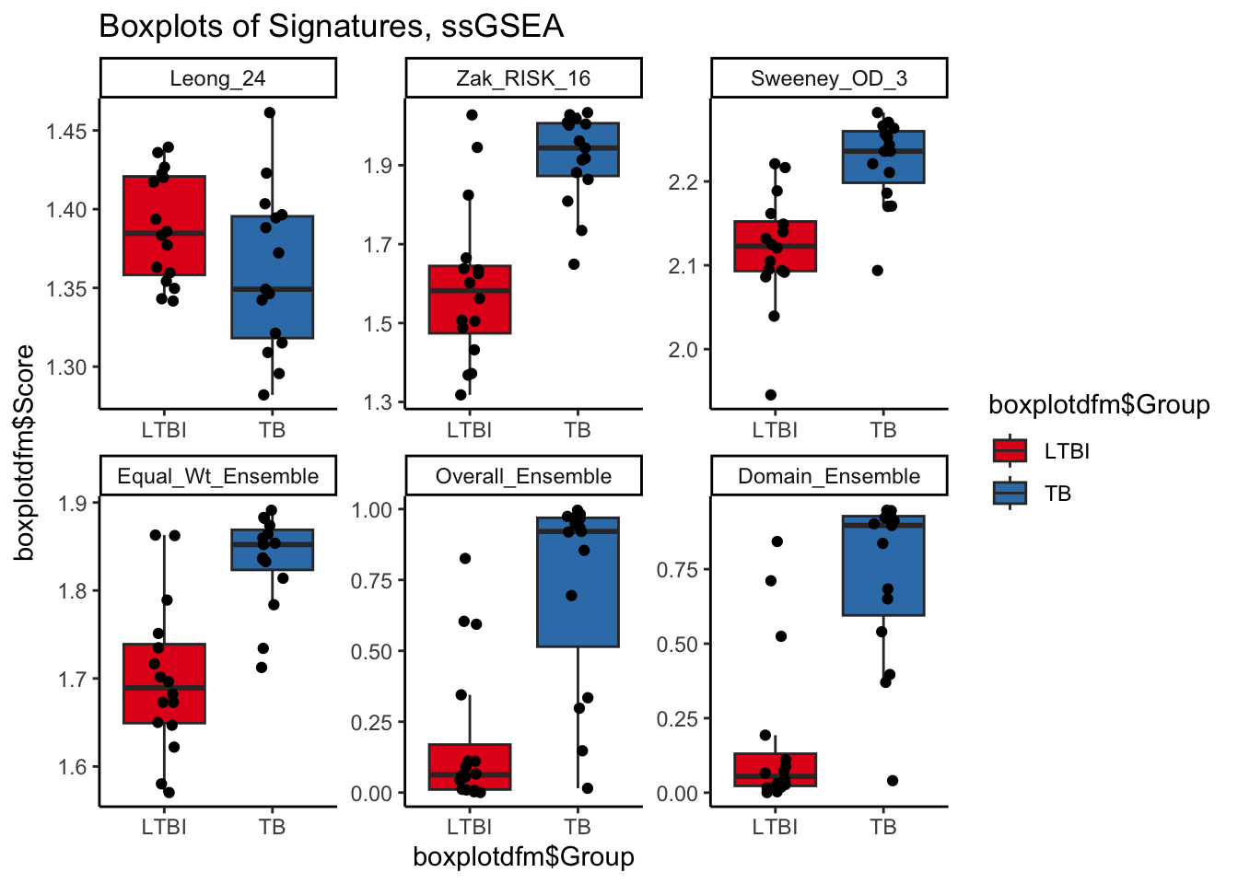

Indian Dataset
Ugandan Dataset
Country | Equal Weights | Ensemble Weights | Domain Weights
India | 0.93 | 0.96 | 0.97
Africa | 0.88 | 0.90 | 0.91
Howard Fan

Slide 10
What Is Federated Learning
A federated database connects multiple independent databases into a single virtual environment, without physically integrating them.
Data is retained where it is stored (local site systems keep ownership).
Users and applications interact with the system as if it were one cohesive data source.

Slide 11
Key Features
Seamless and integrated access to distributed data.
Participating sites keep control of their data.
Common query layer reduces duplication of data transfers.
Standardized metadata supports consistent definitions across systems.
Scalable architecture that accommodates additional country sites.

Slide 12
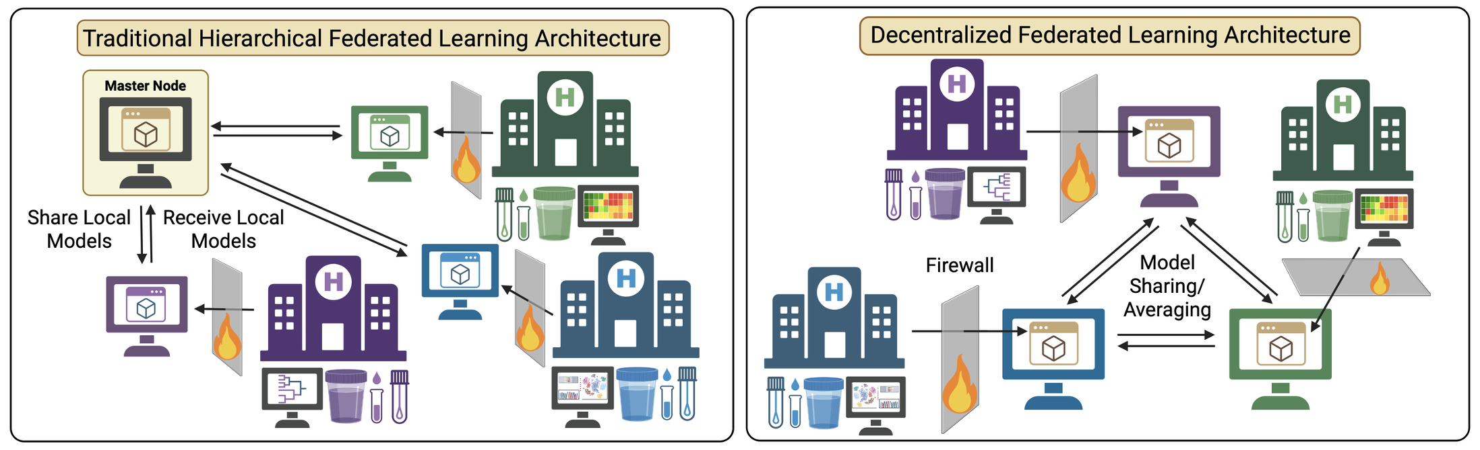
Architectures -- Hierarchical

Slide 13
Architectures -- Decentralized

Slide 14
Why Use a Federated Database?
Reduces long-term burden on sites by avoiding repeated full dataset transfers.
Enables near-real-time access to updated data for reporting and analyses.
Improves data quality and simplifies harmonization process, as it is now done at the source.
Strengthens cross-project collaboration without centralizing data.
Supports compliance by keeping identifiable data local.

Slide 15
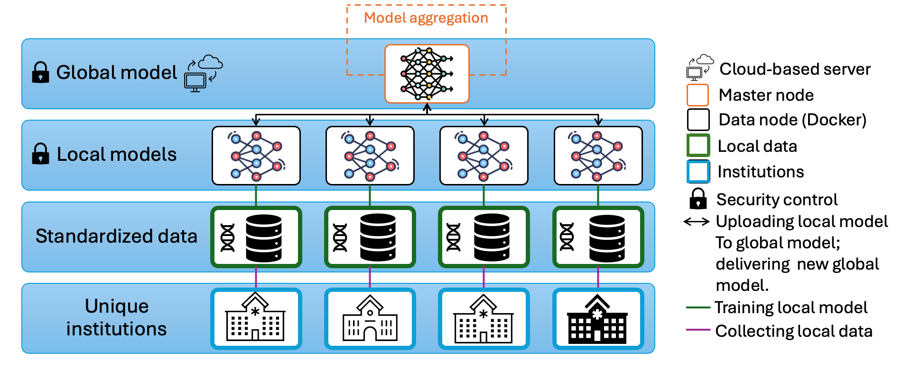
More on Federated Learning
Containerized FL clients (Docker/Singularity)
Central orchestrator with authentication
Zero data movement out of sites

Slide 16

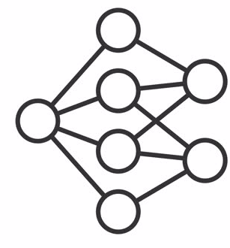
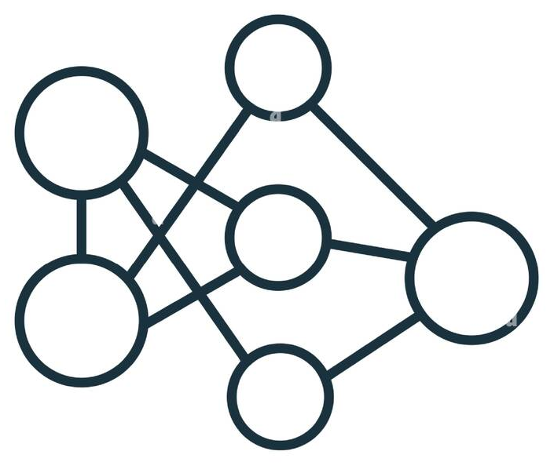
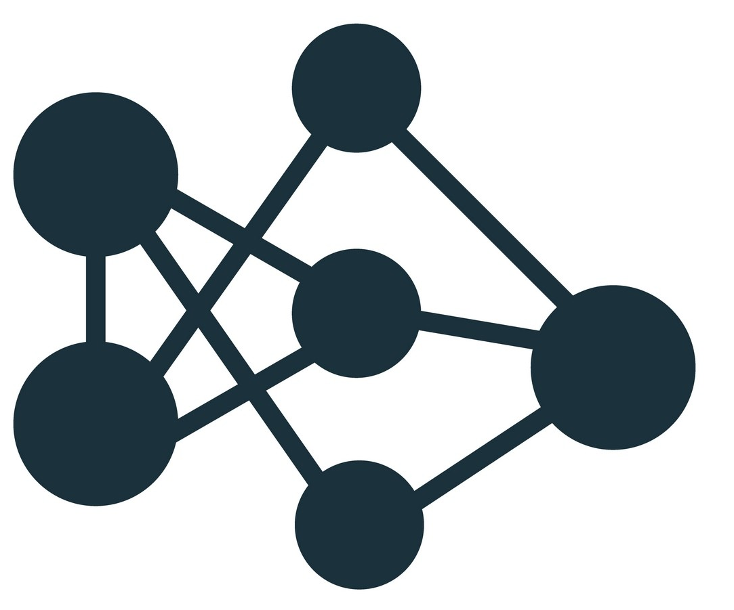



Federated GLM & Foundation Models
Privacy
Federated Foundation Models (FM):
Domain Models (DM) enhance FMs with domain-specific knowledge via Federated Foundation Models
FMs improve DMs’ generalization across sites
Parameter-efficient fine-tuning with all data kept local
Pre-trained
Foundation Model
Enhancement
Guidance
Domain
Models
Efficiency
…
Utility
https://arxiv.org/pdf/2502.12176

Slide 17
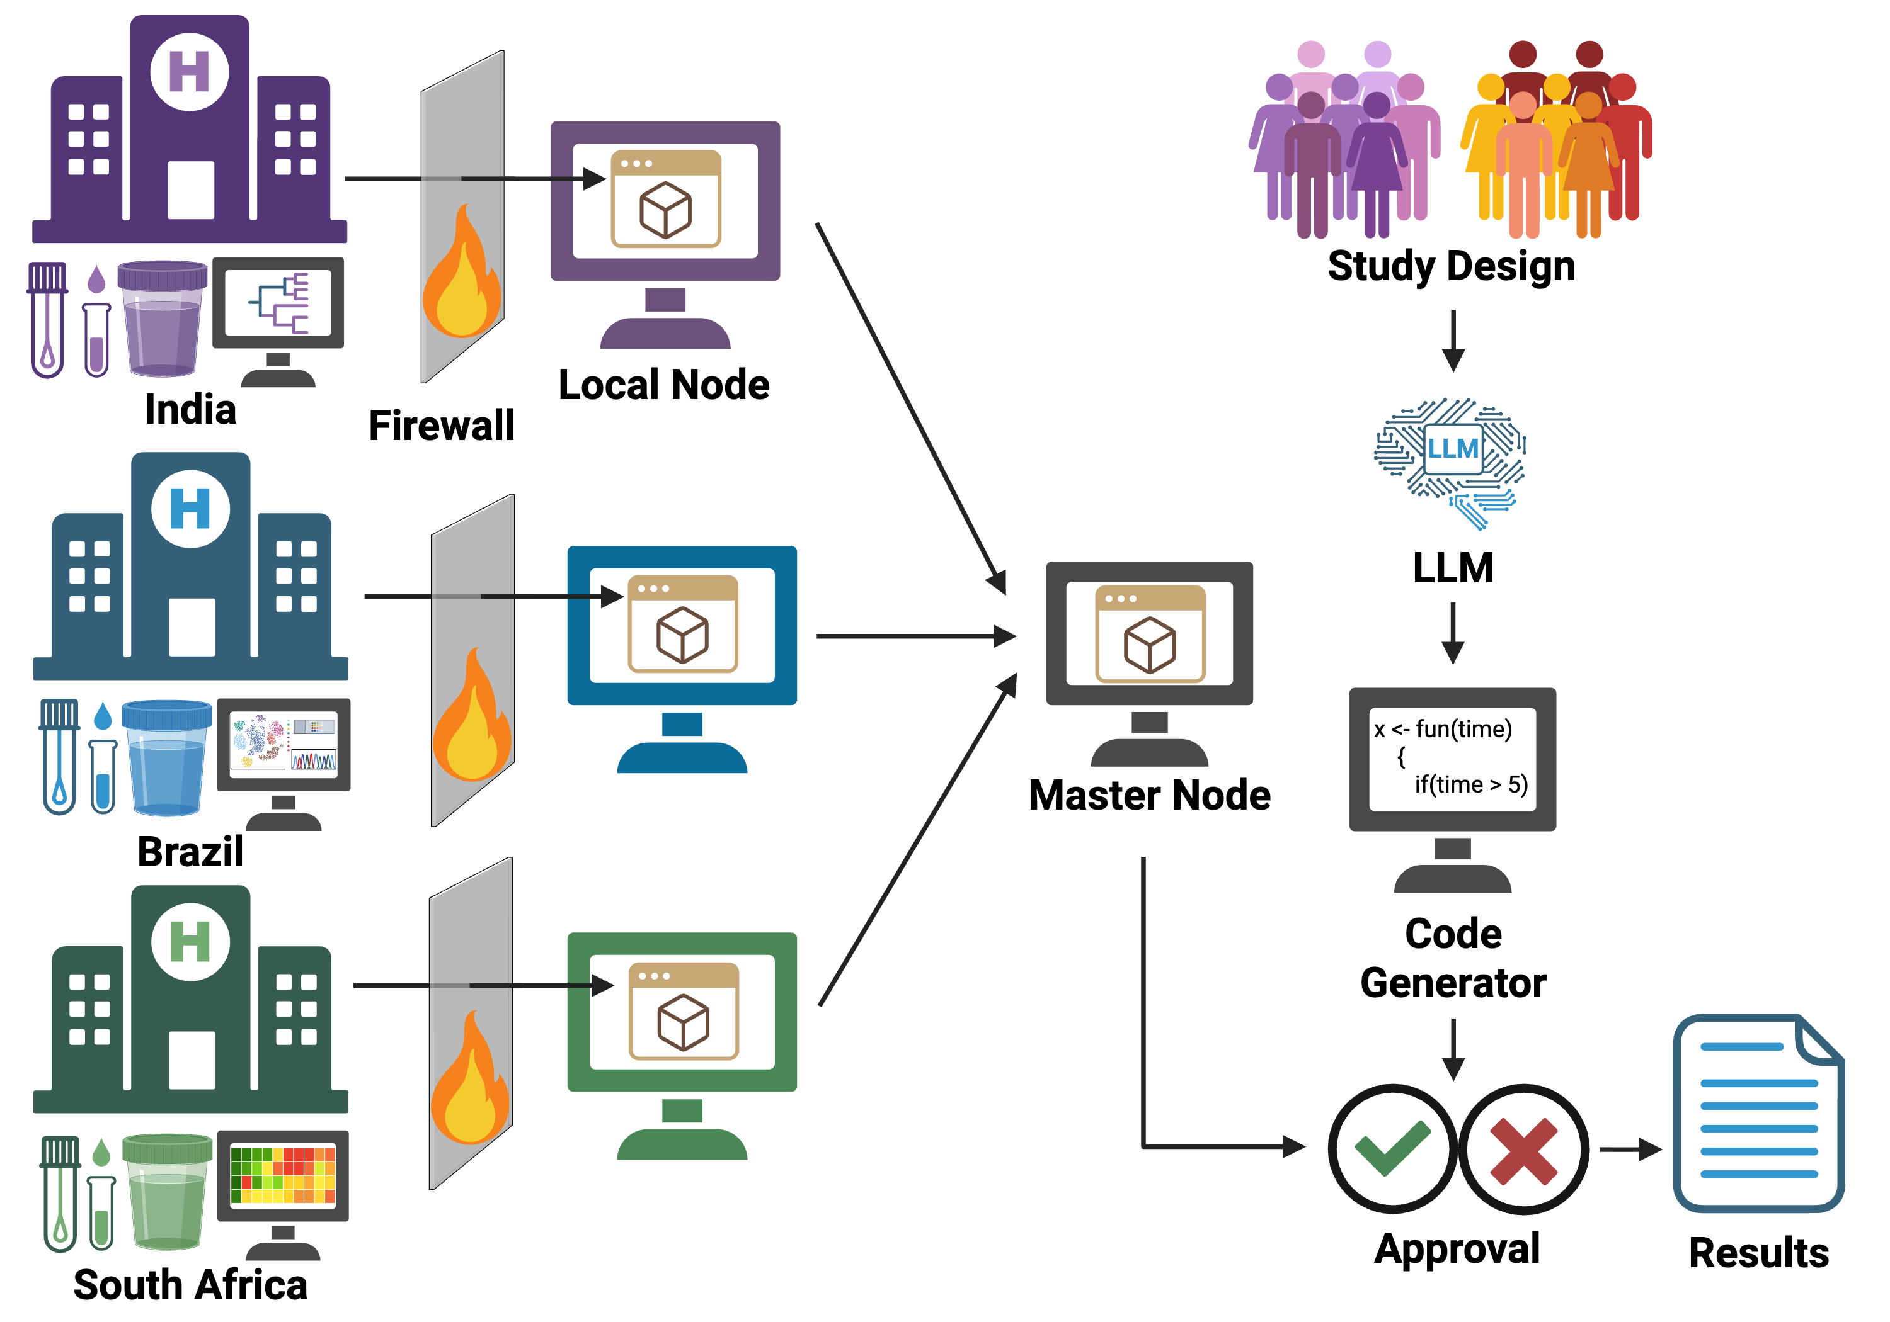
LLM-Generated Code + Safe Execution Layer
Overview: Build an LLM-Driven Code Generator & Executor Embedded in the Federated System
Purpose:
Reduce analysis burden on sites (mirroring the Federated DB goal of reducing repeated requests).
Use LLMs to enable user-driven analysis requests
Automatically harmonize queries using standardized metadata.
Capabilities:
Interpret investigator requests (“run logistic regression on Long TB”).
Generate privacy-safe, site-local Python/R code.
Execute code inside containerized, sandboxed compute nodes.

Slide 18

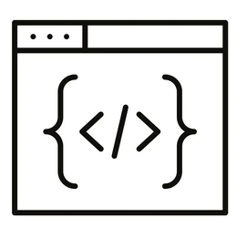


LLM-Generated Code + Safe Execution Layer
Governance, Logging & Safety
User Interaction Layer
User provides analysis request
LLM interprets query
Code Generator
LLM refines analysis plan and
generates metadata-aware code
Master Node
Code Review & Privacy Check
Send approved execution tasks to
Local Node
End-to-end workflow for the LLM-based federated analysis system.

Slide 19
Key Challenges
Do we want a federated system?
Its functionally possible – is it conceptually possible?
Problems with adoption?
Will it really streamline projects/analyses?
Where to do we get funding?
How much funding will determine scope

Slide 20
Thank You!
Discussion

